Slide 1

OLSRv2 Simulation for MANET
Final presentation

Slide 2
Agenda
Introduction & Project Description
Optimized Link State Routing Protocol Ver. 2
Protocol Analyses
Project Architecture
The Simulator
Questions & Open Discussion

Slide 3
Introduction &Project Description
Simulating MANET environment implementing OLSRv2 protocol
Event Driven Simulator
Three modes
Static
Dynamic
Mixed
Different station movement speeds.

Slide 4
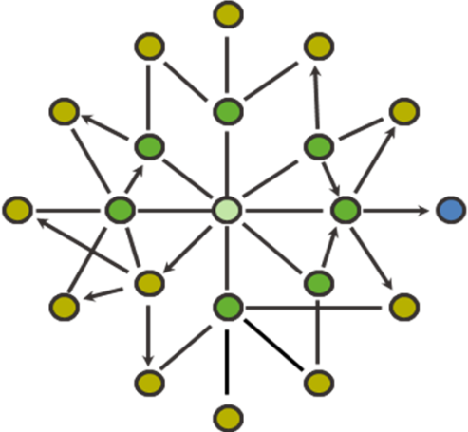
Optimized Link Status Protocol
Based on 1-hop & 2-hop Neighbors sets
Multi Point Relay set

Slide 5
Optimized Link Status Protocol
MPR
Each node notifies its MPR set for their nomination
MPRs broadcast their new role
All nodes can now build a routing table
MPR
Target
MPR
MPR
MPR
Source
MPR

Slide 6
Protocol Analysis
Minimal MPR selection is much better then selecting all neighbors as MPRs

Slide 7
Protocol Analysis Cont.
Cluster topology vs. Uniform topology.
At some point in Cluster topology some stations become a “bottle-neck” and utilization drops.

Slide 8
Protocol Analysis Cont.
Selecting the mode in which data could be passed only through MPRs, actually helped keeping the utilization high even in higher data packets rates.

Slide 9
Protocol Architecture
Log
GUI
GUI
Log
OLSR Nodes
Event Gen
Topology Mgr
Tasks Queue
Dispatcher
Tasks Queue
OLSRv2 Layer
(per node)
Event Generator
Dispatcher
Topology Manager

Slide 10
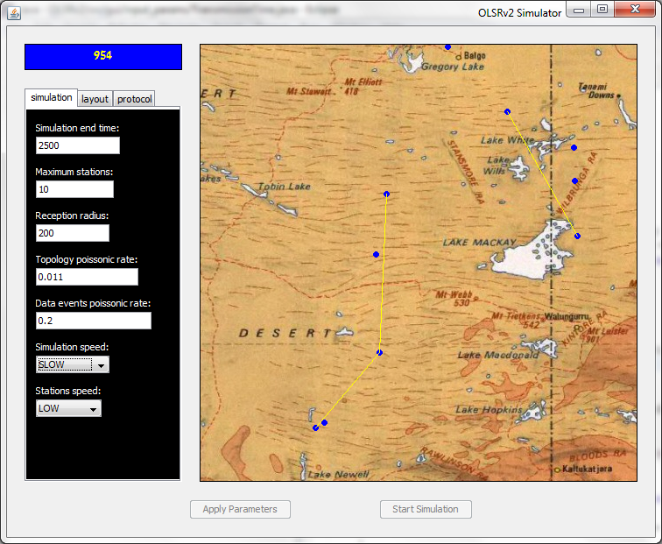
The Simulator
Different parameters
Simulation Time
Data Transfer Between Stations

Slide 11
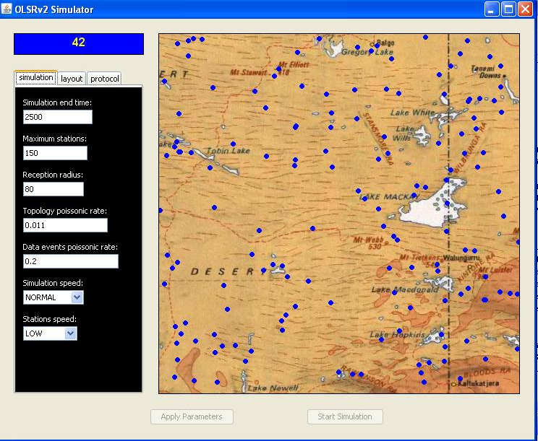
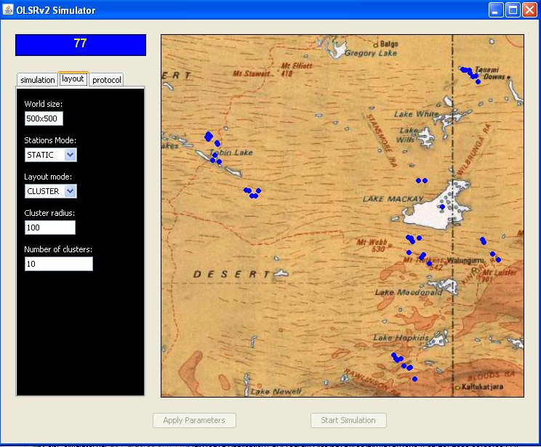
The Simulator Cont.
Cluster Distribition
Uniform formation

Slide 12
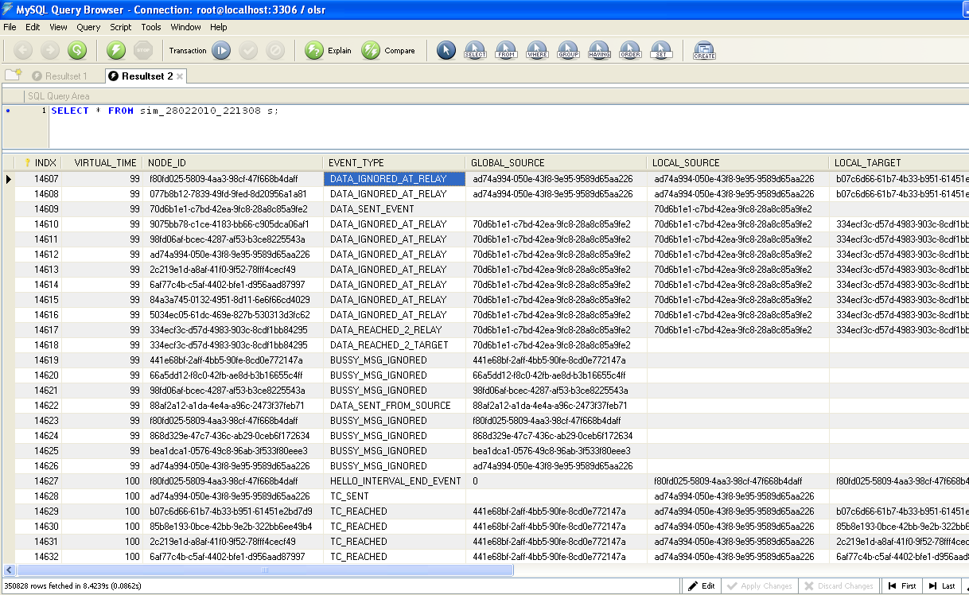
The Simulator – Logger &SQL
Data Send & Receive
Congestion Ctrl.
TC Msg. Send & Receive

Slide 13
Questions
&
Open Discussion

Slide 14
Thank you !
Assaf Israel
Eli Nazarov
Asi Bross

